Slide 1
Team Members
Project II
Data Visualization
Syed “Asif” Ali
Xeniya “Sana” Rogers
Meredith Johnson

Slide 2
Issue Articulation
As Americans return to a more familiar daily life, they may be eager to enjoy a meal out with family and friends.
We understand routines were disrupted and small businesses suffered – particularly the local restaurant industry.
Our project analyzes and maps local restaurant choices and provides sales rankings, average check pricing and more so that people can discover, support and enjoy small, family-owned or independent restaurants in their backyard and beyond!

Slide 3
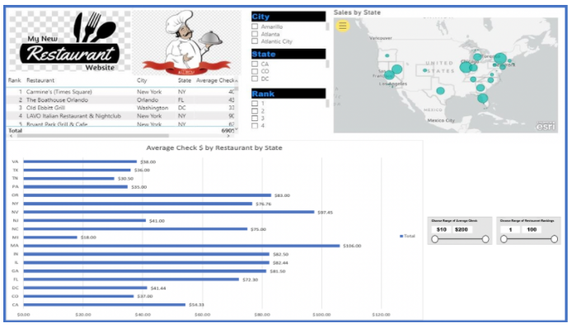




Solution
User Interactive Visualization
Average Check by Restaurant
Location of Restaurant
Popularity of Restaurants by Meals Served

Slide 4
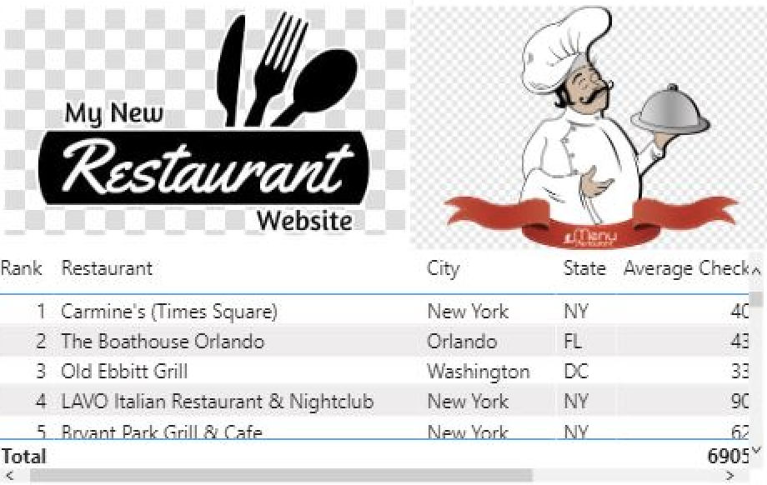
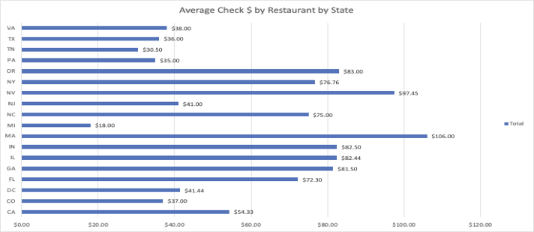
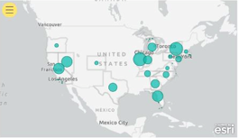
Dashboard Vision Creating Data Driven and User Interactive Visuals for Exploring Top US Independent Restaurants
Data Set
Table
Kaggle Data Set: https://www.kaggle.com/michau96/restaurant-business-rankings-2020?select=Independence100.csv
Bar Chart
Mapping

Slide 5
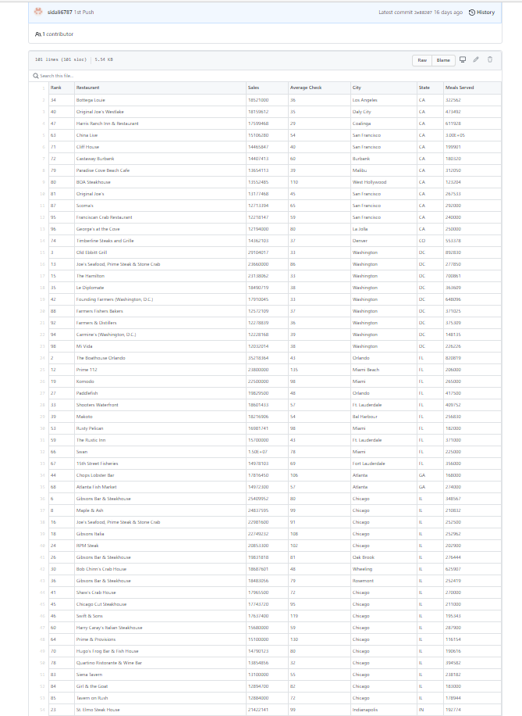
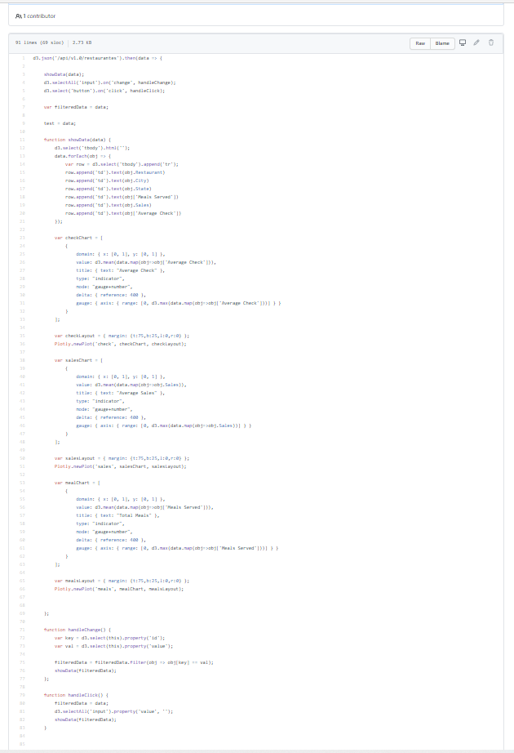
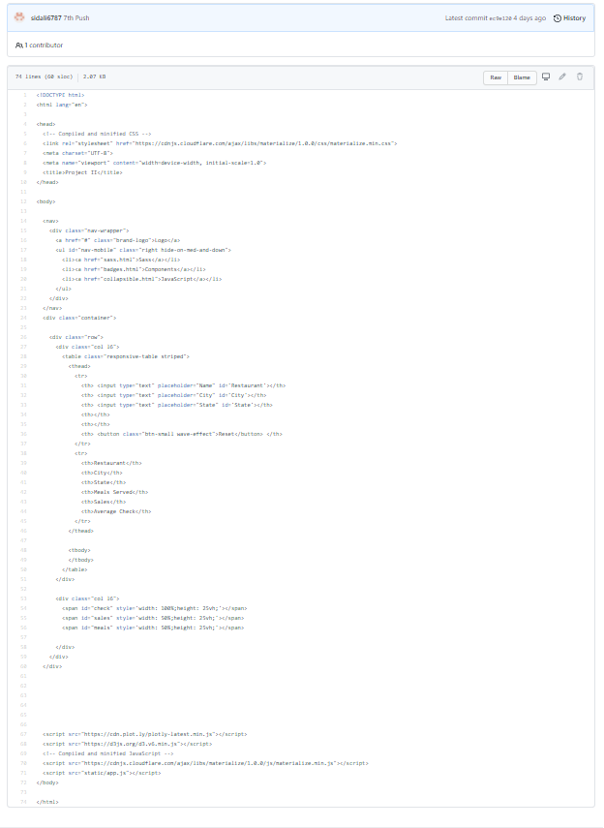
Coding Process
Data – CSV file
Static – app.js
Templates - html

Slide 6

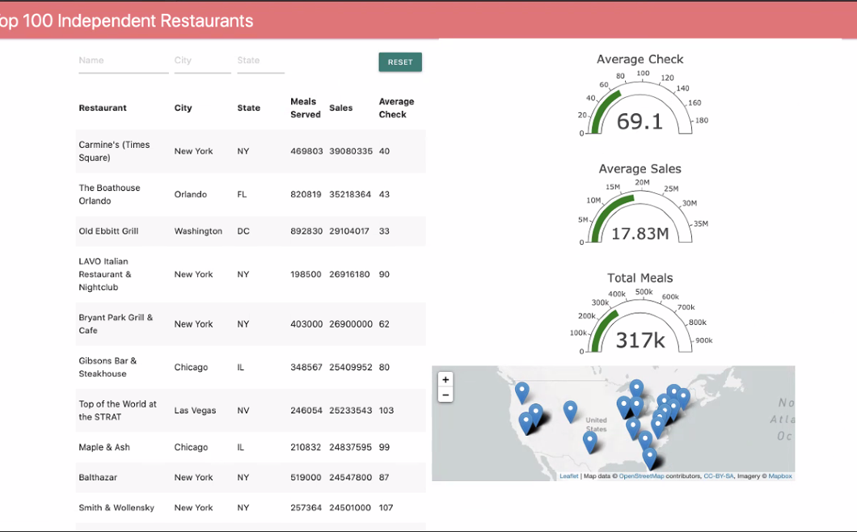
PRODUCT
Interactive Dashboard
Languages
Web Enhancers
Python
JavaScript
HTML
Python – Flask powered API
CSS
Libraries & Databases
Leaflet - mapping
Plotly - gauge
Materialize – header; not covered in class
D3.js – thick server interaction
MongoDB - database

Slide 7
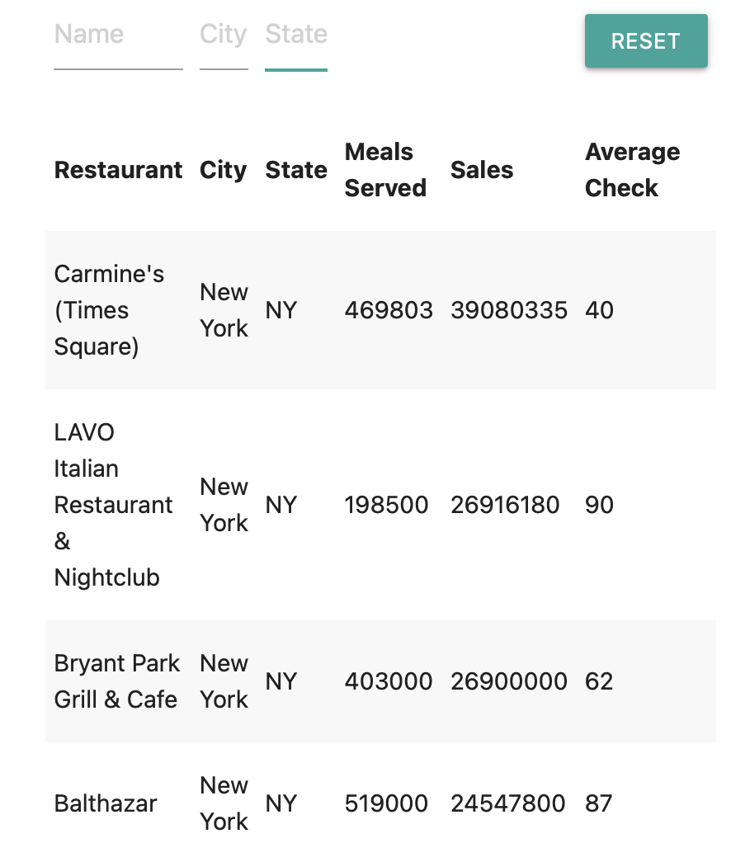
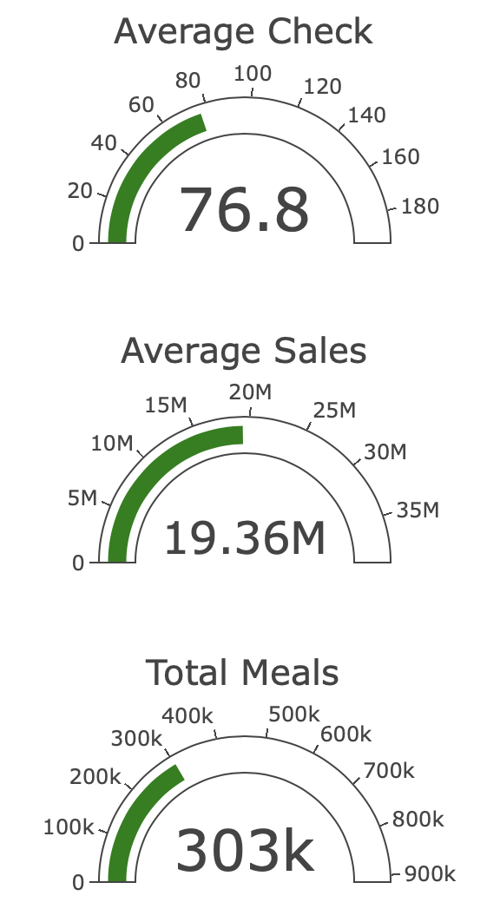
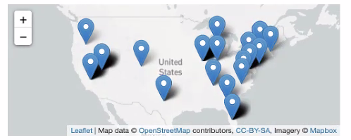
Interactive Visualizations
User Engagement
Table View
Gauge View
Map View

Slide 8
Data Visualization
Interactive Demo

